Slide 1
Introduction to Multi-objective Optimization and Decision-making
Kalyanmoy Deb
University Distinguished Professor
Koenig Endowed Chair Professor
Michigan State University
East Lansing, USA
kdeb@egr.msu.edu
http://www.egr.msu.edu/~kdeb

Slide 2
Outline of the Tutorial
Multi-objective Optimization (MOO)
Evolutionary Multi-objective Optimization (EMO)
EMO Methods
EMO and Decision Making
Summary

Slide 3
Multi-Objective Optimization: Basics
Bueno, Bonito, Barato?
Good,
nice,
cheap
Have you wondered?
3B
Efficient cars
Non-inferior cars
A doomed car
A “Dominated” car

Slide 4
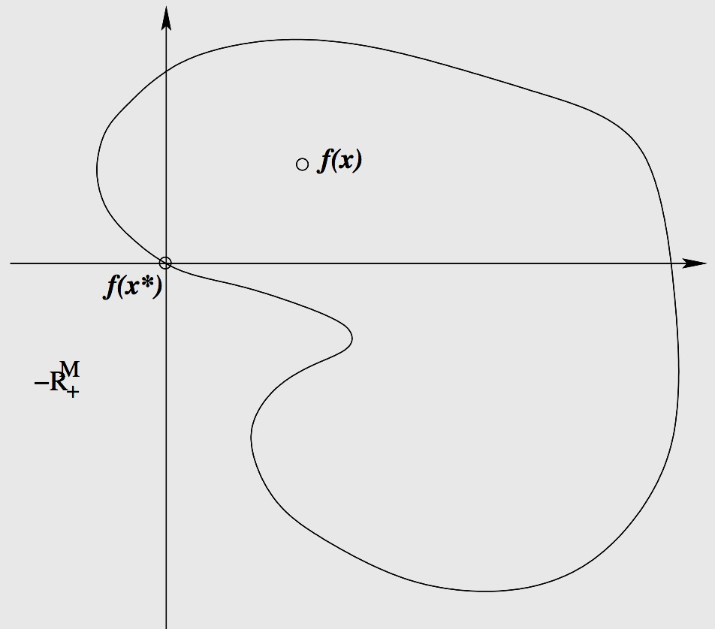
MOO Basics: Domination
$$x_{2}$$
A
$$X$$
X
Variable Space
$$x^{∗}$$
B
C
D
A solution $x^{∗}∈X$is Pareto-optimal if there is no $x∈ X$ such that
${ f}_{i}(x)≤f_{i}(x^{∗})$ for $i=1,…,M$
AND $f_{j}(x)<f_{j}(x^{∗})$ for some $j$
Place top-right corner of a paper on the point z*
If no point exists on the paper, z* is efficient
$$X$$
$$x_{1}$$
Objective Space
X
A
$$f(x^{∗})$$
$$Z$$
B
$$f(x)$$
No point should exist on axis lines as well
C
$$f(x^{∗})$$
D

Slide 5
Classical Point-based MOO Principle
Results in a single solution in each simulation
Apply multiple times to generate an efficient set

Slide 6
Difficulties with Weighted-Sum Method
Need to know w
Non-uniformity in Pareto-optimal solutions
Inability to find some Pareto-optimal solutions (those in non-convex region)
However, a weighted-sum solution of this approach is always Pareto-optimal

Slide 7
Classical Approach: $ε$-Constraint Method
Constrain all but one objective
Need to know relevant $ε$ vectors
Non-uniformity in Pareto-optimal solutions
However, any Pareto-optimal solution can be found with this approach

Slide 8
Difficulties with Classical Approaches
Need to run a single-objective optimizer many times
Expect a lot of problem knowledge
Multi-objective optimization treated as an application of single-objective optimization
Absence of any parallel search

Slide 9
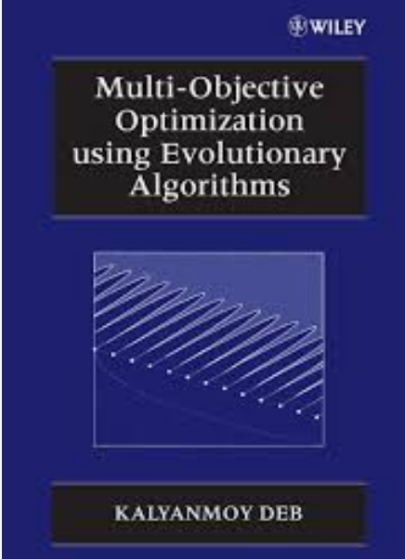
Evolutionary MOO (EMO): Basics
Step 1 :
Find a set of Pareto-optimal solutions
Step 2 :
Choose one from the set
Pragmatic approaches
Deb, K. (2001). Multi-objective optimization using evolutionary algorithms. Wiley
(First book on EMO, Google Scholar Citation: 20K+)

Slide 10
EMO: Early Methods
Early penalty-based approaches
VEGA (1984)
Goldberg's suggestion (1989)
MOGA, NSGA, NPGA (1993-95) used Goldberg’s suggestion
Elitist EMO (SPEA, NSGA-II, PAES, MOMGA etc.) (1998 -- Present)
10,297
NPGA
SPEA
NSGA-II
ℇ-MOEA
MOEA/D
NSGA-III
MOGA
NSGA
R-NSGA-II
SMS-MOEA

Slide 11
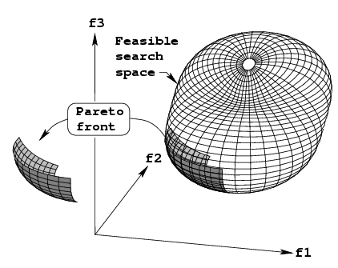
Elitist Non-dominated Sorting Genetic Algorithm (NSGA-II)
NSGA-II
Modular
No additional parameter
Fast
Commercialization:
Heeds (NSGA-II like)
ModeFrontier (Estico)
iSIGHT (Engeneous)
VisualDoc (Vanderplatts)
Fast-Breaking Paper in Engineering by ISI Web of Science (Feb’04), Thomson Citation Laureate Award 2006, Current Classic and Most Highly Cited Paper (>55,000+ Google Scholar citations)
pymoo.org for a python code
Deb, K., Pratap. A, Agarwal, S., and Meyarivan, T. (2002). A fast and elitist multi-objective genetic algorithm: NSGA-II. IEEE Transaction on Evolutionary Computation, 6(2), 181–197

Slide 12
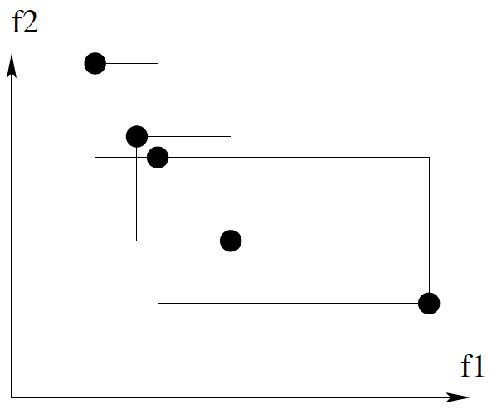
NSGA-II Procedure
TS_{(R,CD)}(A,B):
if R_{A} < R_{B}, choose A
if R_{B} < R_{A}, choose B
else //A & B non-dominated
if CD_{A} > CD_{B}, choose A
if CD_{B} > CD_{A}, choose B
else choose rand(A,B)
Elites are preserved
Non-dominated solutions are emphasized
Each soln has Rank R and Crowd. Dist. CD
TS(R,CD), Xover, Mut
Deb, K., Pratap. A, Agarwal, S., and Meyarivan, T. (2002). A fast and elitist multi-objective genetic algorithm: NSGA-II. IEEE Transaction on Evolutionary Computation, 6(2), 181–197

Slide 13
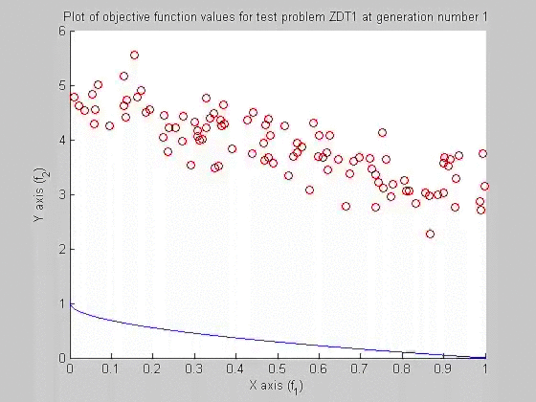
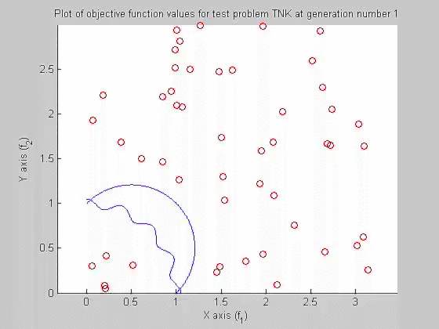
Examples of NSGA-II Simulations
Unconstrained 2-objective
Problem ZDT1
Constrained 2-objective
Problem TNK

Slide 14
Why EMO Does So Well?
Population approach suits well to find multiple solutions
Niche-preservation methods can be exploited to find diverse solutions
Implicit parallelism helps provide a parallel search
Multiple applications of classical methods do not constitute a parallel search

Slide 15
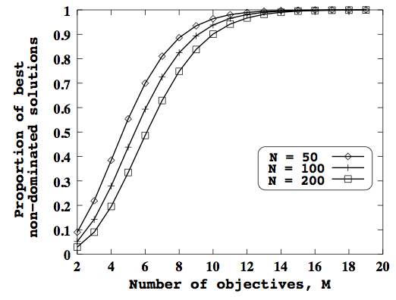
Evolutionary Many-Objective Optimization
Multi-objective: {2,3} objectives
Many-objective: >3 objectives
EMO difficulties for many-obj. problems:
Large fraction of population gets dominated
Dominant resistant solns.
Maintaining diversity difficult

Slide 16
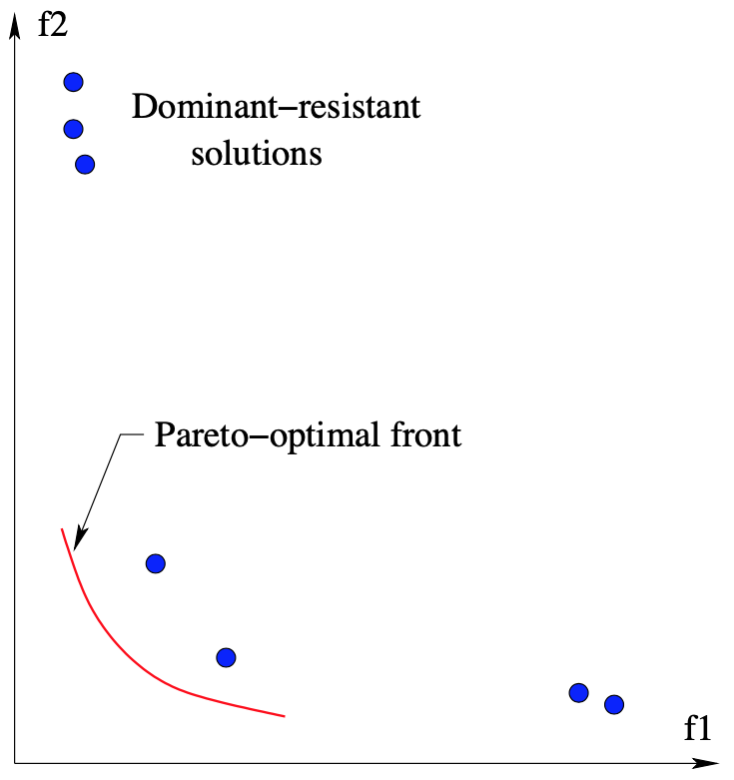
Evolutionary Many-Objective Optimization
Multi-objective: {2,3} objectives
Many-objective: >3 objectives
EMO difficulties for many-obj. problems:
Large fraction of population gets dominated
Dominant resistant solns.
Maintaining diversity difficult

Slide 17
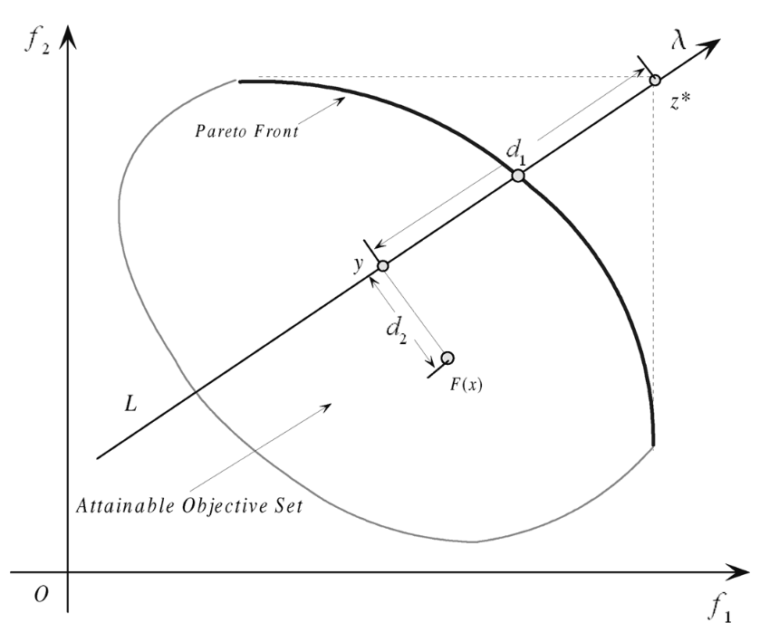
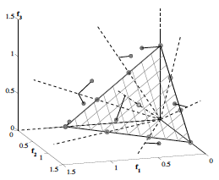
Decomposition Based EMO:MOEA/D
Multiple reference lines
Random association at first
Points from neighboring (T) lines are mated
Offsprings are associated with a line based on min.
Offspring can replace r parents
Original study to 2-3 obj. Additional Param: T, 𝛳, r
Zhang, Q., & Li, H. (2007). MOEA/D: A multiobjective evolutionary algorithm based on decomposition. IEEE Transactions on evolutionary computation, 11(6), 712-731.

Slide 18
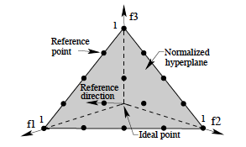
NSGA-III: Step 0: Supply of Reference Points
If no preference, use Das-and-Dennis’s approach
# pts.:
Else, supply a preferred set of reference points
Points are given on the normalized hyper-plane
Any other structured set of points can also be supplied
p=4, M=3, H=15
Deb, K. and Jain, H. (2014). Evolutionary Many-Objective Optimization Algorithm Using Reference-point Based Non-dominated Sorting Approach, Part I: Solving Problems with Box Constraints. IEEE Transactions on Evolutionary Computation, 18(4), 577–601.

Slide 19
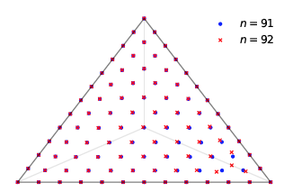
NSGA-III: Step 0: Supply of Reference Points
If no preference, use Das-and-Dennis’s approach
# pts.:
Else, supply a preferred set of reference points
Points are given on the normalized hyper-plane
Any other structured set of points can also be supplied
p=4, M=3, H=15
Uniform
Unit-simplex
(Blank and Deb, 2020)
Deb, K. and Jain, H. (2014). Evolutionary Many-Objective Optimization Algorithm Using Reference-point Based Non-dominated Sorting Approach, Part I: Solving Problems with Box Constraints. IEEE Transactions on Evolutionary Computation, 18(4), 577–601.

Slide 20
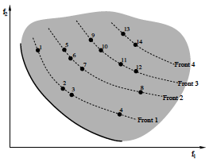
NSGA-III: Step 1: Identification of Non-dominated Fronts
Parent and offspring population combined to R
Non-dominated sorting of R
Collect and save fronts 1 to l to S, delete other fronts
If |S|=N, P_{t+1} = S, go to next iteration
Else, P_{t+1} = {F₁,…,F_{l-1}}, remaining pts chosen from F_{l}
F_{l}
P_{t+1}
N=7
Deb, K. and Jain, H. (2014). Evolutionary Many-Objective Optimization Algorithm Using Reference-point Based Non-dominated Sorting Approach, Part I: Solving Problems with Box Constraints. IEEE Transactions on Evolutionary Computation, 18(4), 577–601.

Slide 21
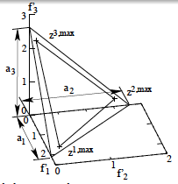
NSGA-III: Step 2: Normalization of Population Members
Identify ideal point of S
Translate all members of S to make new ideal pt. as origin
Identify extreme pts.:
Update with previous extreme pts.
Normalize using ideal and extreme points obtained
Deb, K. and Jain, H. (2014). Evolutionary Many-Objective Optimization Algorithm Using Reference-point Based Non-dominated Sorting Approach, Part I: Solving Problems with Box Constraints. IEEE Transactions on Evolutionary Computation, 18(4), 577–601.

Slide 22
NSGA-III: Step 2: Association of Population Members
Reference line for each ref. pt. is found
The ref. pt. having shortest perpendicular dist. from a S member is associated
A reference point may have zero, one, or more than one S members associated
Deb, K. and Jain, H. (2014). Evolutionary Many-Objective Optimization Algorithm Using Reference-point Based Non-dominated Sorting Approach, Part I: Solving Problems with Box Constraints. IEEE Transactions on Evolutionary Computation, 18(4), 577–601.

Slide 23
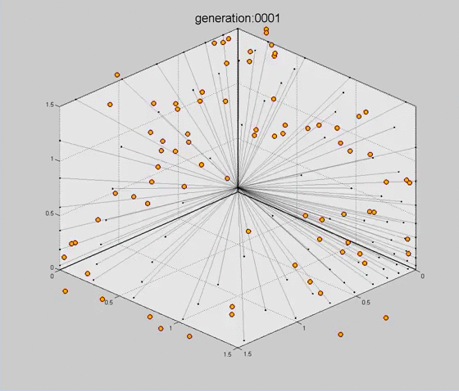
Simulation of NSGA-III on 3-Obj. Problem
Deb, K. and Jain, H. (2014). Evolutionary Many-Objective Optimization Algorithm Using Reference-point Based Non-dominated Sorting Approach, Part I: Solving Problems with Box Constraints. IEEE Transactions on Evolutionary Computation, 18(4), 577–601.

Slide 24
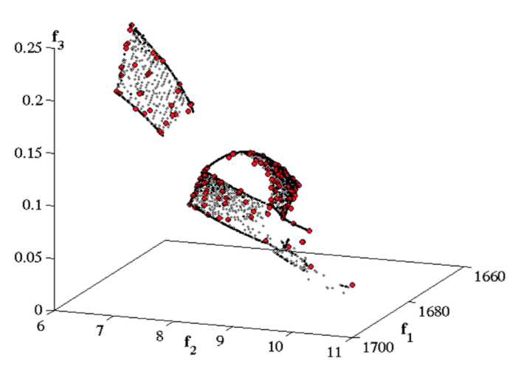
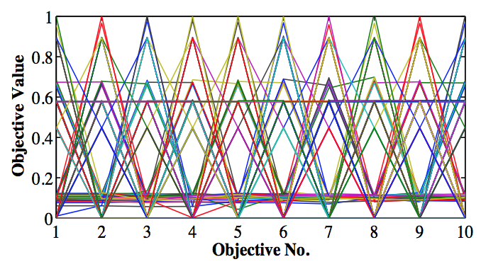
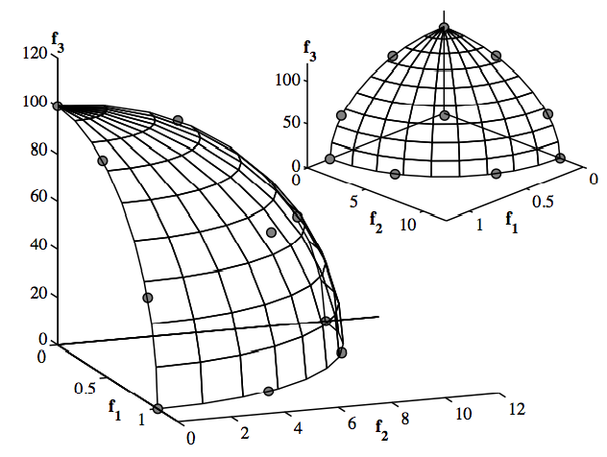
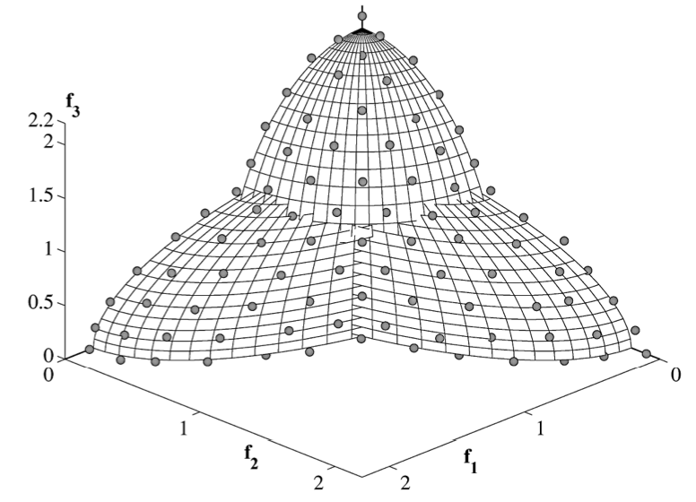
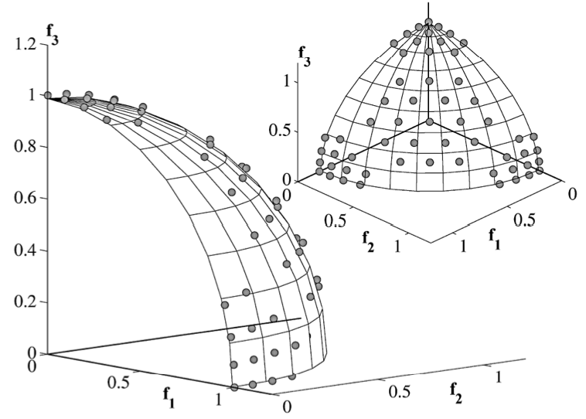
More Results of NSGA-III
10-obj.
Problem
Crashworthiness
A few
Solutions
Constrained
Problem
Constrained
Problem
Deb, K. and Jain, H. (2014). Evolutionary Many-Objective Optimization Algorithm Using Reference-point Based Non-dominated Sorting Approach, Part I: Solving Problems with Box Constraints. IEEE Transactions on Evolutionary Computation, 18(4), 577–601.

Slide 25
Making Decisions: A-priori or A-Posteriori
Ranking based on closeness to each reference point or a reference direction
R-NSGA-II: Deb and Sundar (GECCO 2006)
Deb, K., & Sundar, J. (2006). Reference point based multi-objective optimization using evolutionary algorithms. In Proceedings of the 8th annual conference on Genetic and evolutionary computation (pp. 635-642).
Notes:
Posteriori

Slide 26
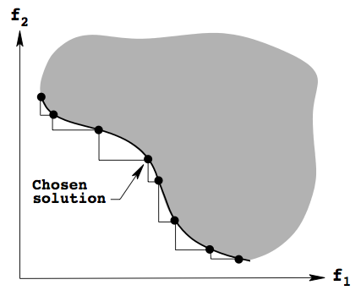
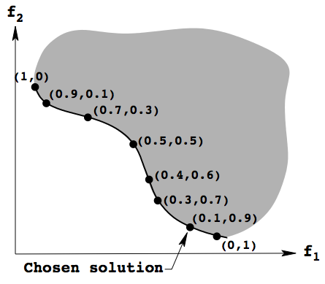
A-Posteriori Approaches
Trade-off Approach
Recent Applications
Pseudo-weight Approach
Choose a solution close to desired weight combination
Trade-off = $\frac{Loss}{Gain}$
Desired weight
(0.67,0.33)
Interactive EMO-MCDM methods are surfacing

Slide 27
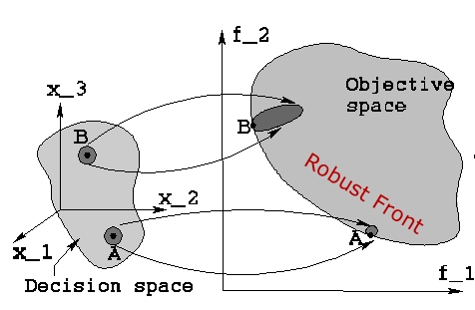
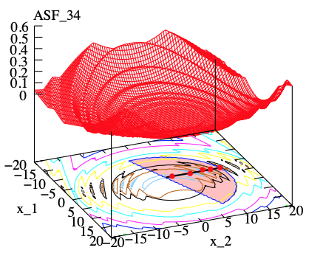
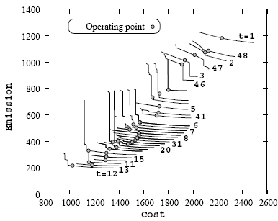
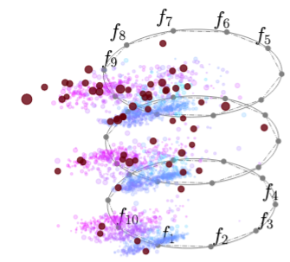
EMO for Handling Practicalities
Metamodeling based EMO
Uncertainty handling EMO
Distributed computing in EMO
Dynamic EMO
Redundant objectives in EMO
Bilevel (Hierarchical) EMO
Visualization
PaletteViz

Slide 28
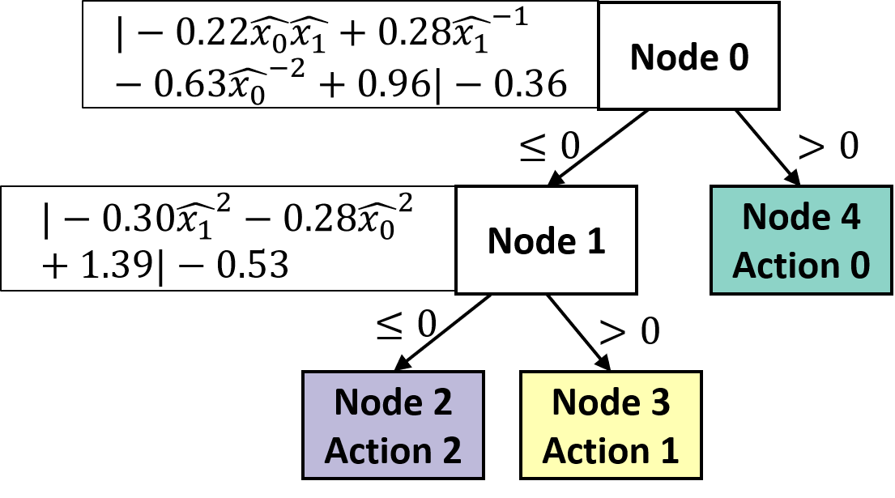
Innovization (Knowledge Discovery)
Variables of Pareto set often contain patterns
Due to optimality conditions each solution must satisfy
Machine learning to extract patterns (features)
NAS: Subnet is common or certain weights are identical in all Pareto solutions
Knowledge Extraction from Good Solns
Interpretable NLDT
(2.4 rules, 2.97 terms)
DNN (151,941 weights)

Slide 29
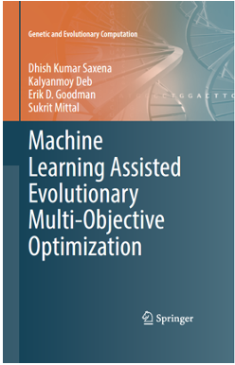
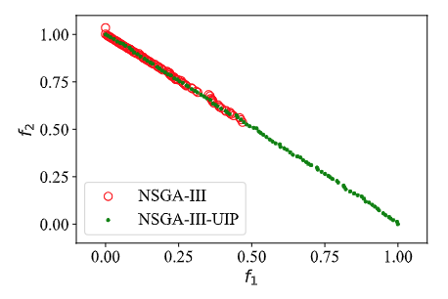
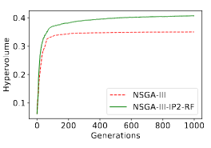
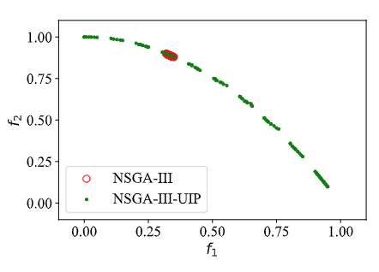
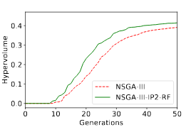
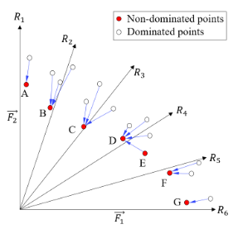
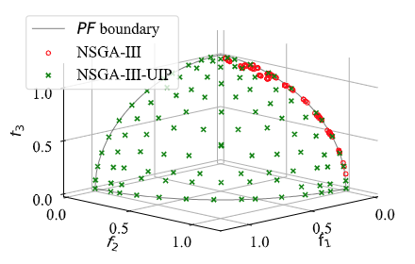
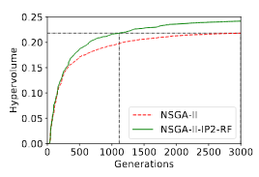
Machine Learning to Improve EMO’s Performance
CIBN1
Learn from EMO’s progress
Use ML (RF) to repair
WFG9-3obj
DASCOMP1
(Mittal, et al., 2020
DTLZ4-3obj
DASCOMP9
Gearbox-3obj
Mittal, S., Saxena, D. K., Deb, K. and Goodman, E. D. (2022). A Learning-based Innovized Progress Operator for Faster Convergence in Evolutionary Multi-objective Optimization. ACM Transactions on Evolutionary Learning and Optimization, 2(1), 1–29.

Slide 30
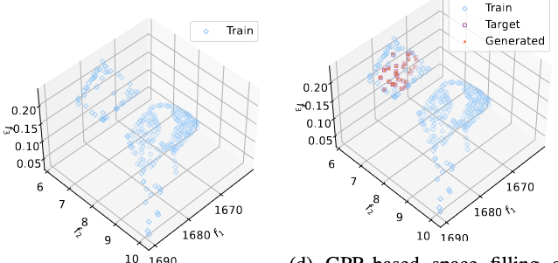
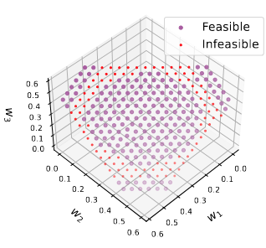
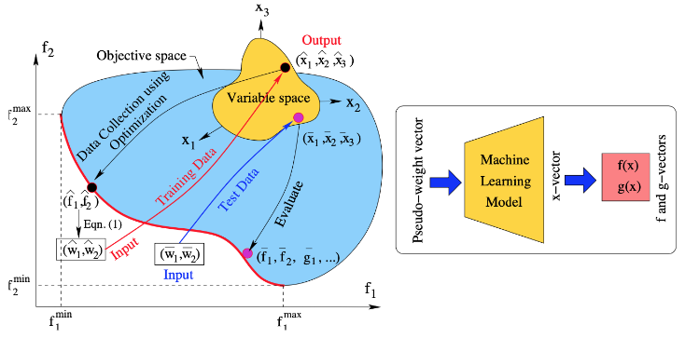
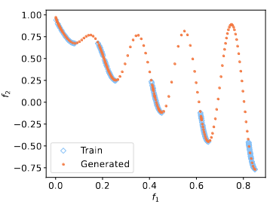
ML-Assisted EMO: Analyze the PO Front
Capture pseudo-weight and variable relations
Find more solutions in preferred areas without any more function evaluations
Deb, K., Gondkar, A., and Anirudh, S. (2023, March). Learning to Predict Pareto-Optimal Solutions from Pseudo-weights. Proceedings of Evolutionary Multi-Criterion Optimization: EMO 2023, (pp. 191-204).

Slide 31
Summary
Multi-objective optimization allows a pragmatic way to find alternate solutions
Alternate solutions can be used to extract patterns
Problem knowledge for future use
Speed-up optimization task
Commercial softwares available
Heeds, ModeFrontier, iSight, VisualDoc
Computer codes freely downloadable
pymoo, Jmetal, PISA, MOEAFramework, EMOO websites

