Slide 1
Multi-Objective Optimization for Multi-Task Learning
Xi Lin
City University of Hong Kong
https://xi-l.github.io/
xi.lin@cityu.edu.hk
Notes:
1234

Slide 2
Outline
Finding a Single Pareto Solution
Finding a Set of Pareto Solutions
Learning the Whole Pareto Set
Summary

Slide 3
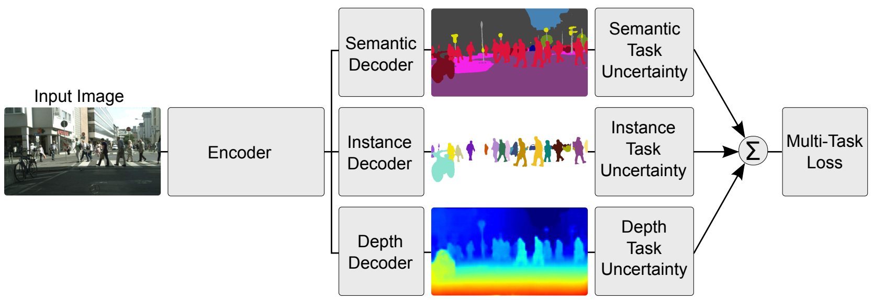
Multi-Task Leanring (MTL)
MTL: solve multiple related tasks at the same time
Gradient-based Optimization: train deep neural network
Classic MTL Loss (Linear Scalarization):
Kendall et. al., Multi-Task Learning Using Uncertainty to Weigh Losses for Scene Geometry and Semantics, CVPR 2018.

Slide 4
Drawbacks of MTL Loss
Weights:
Chosen by the decision-makers
Exhaustive weights search might be needed

Slide 5
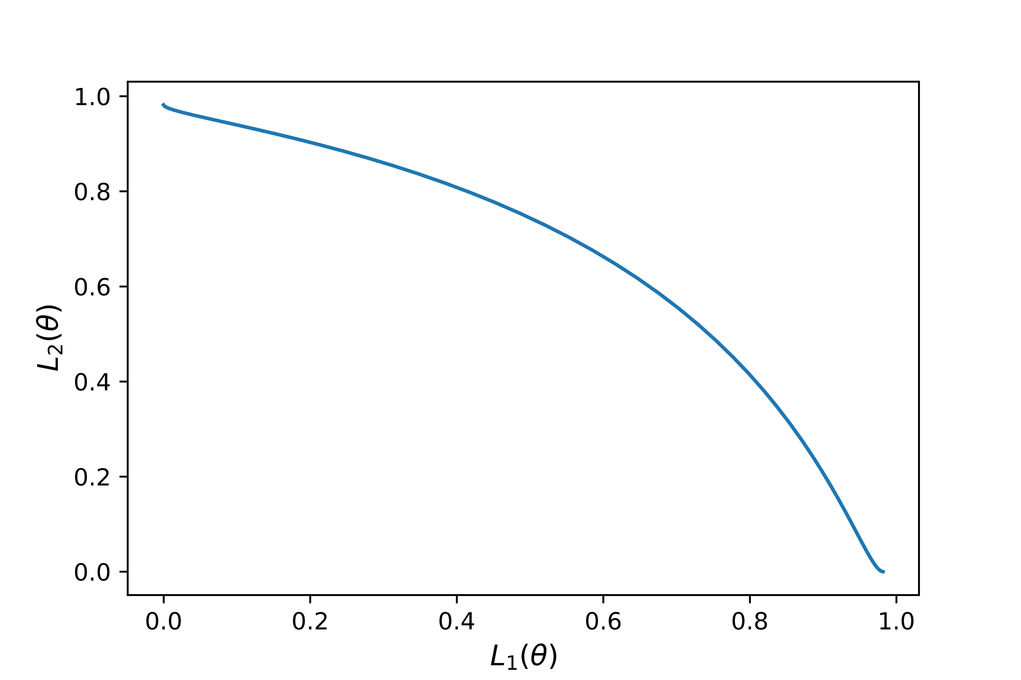
Drawbacks of MTL Loss
Weights:
Chosen by the decision-makers
Exhaustive weights search might be needed
Tasks:
Might be conflicted with each other
No single best solution

Slide 6
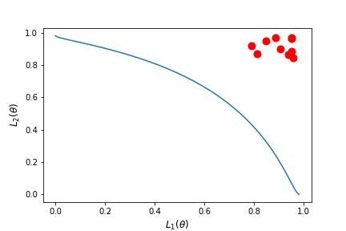
Drawbacks of MTL Loss
Weights:
Chosen by the decision-makers
Exhaustive weights search might be needed
Tasks:
Might be conflicted with each other
No single best solution
Drawback of Linear Scalarization:
Can’t find solutions on non-convex Pareto front^{1,2}
¹Das and Dennis, A closer look at drawbacks of minimizing weighted sums of objectives for Pareto set generation in multicriteria optimization problems,
Structural optimization 1997
²Boyd and Vandenberghe, Convex Optimization, Cambridge University Press 2004.

Slide 7
View Point of Multi-Objective Optimization
Goal: Find a Pareto optimal solution for MTL with gradient-based method

Slide 8
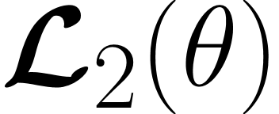
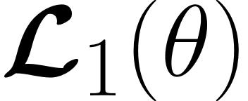
View Point of Multi-Objective Optimization
Goal: Find a Pareto optimal solution for MTL with gradient-based method
Motivation: Karush-Kuhn-Tucker (KKT) Condition¹²
Any that satisfies this condition is called a Pareto stationary solution.
(no gradient direction can improve all objectives simultaneously)
Sener and Koltun, Multi-Task Learning as Multi-Objective Optimization, NeurIPS 2018.
¹Fliege and Svaiter, Steepest descent methods for multicriteria optimization, Mathematical Methods of Operations Research 2000.
²Schäffler et. al., Stochastic method for the solution of unconstrained vector optimization problems. Journal of Optimization Theory and Applications 2002.

Slide 9
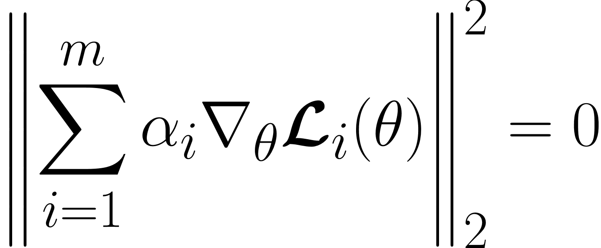
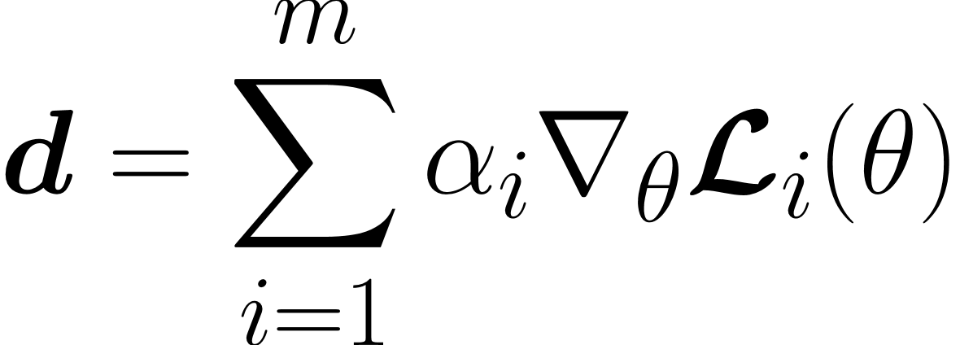
Multi-Gradient Descent Algorithm (MGDA)
Goal: Find a Pareto optimal solution for MTL with gradient-based method
Method: Multi-Gradient Descent Algorithm (MGDA)¹
A:
B:
Pareto Stationary Solution
Valid Gradient Direction
Sener and Koltun, Multi-Task Learning as Multi-Objective Optimization, NeurIPS 2018.
¹Jean-Antoine Désidéri, Multiple-gradient descent algorithm (MGDA) for multiobjective optimization, Comptes Rendus Mathematique 2012.

Slide 10
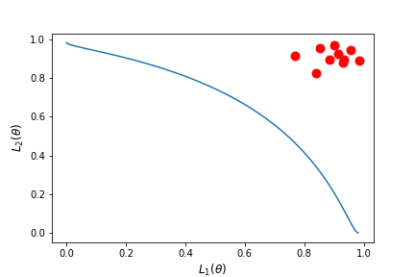
Linear Scalarization v.s. MGDA
a) Linear Scalarization b) MGDA
Linear Scalarization: no solution on non-convex part of the Pareto front
Adaptive Gradient Methods: solution with balanced trade-off

Slide 11
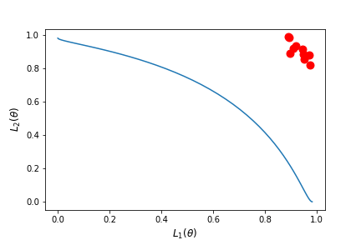
There are Many Pareto Solutions
a) Linear Scalarization b) MGDA c) Pareto MTL
Linear Scalarization: no solution on non-convex part of the Pareto front
Adaptive Gradient Methods: solution with balanced trade-off
Pareto Multi-Task Learning¹: a set of Pareto solutions with diverse trade-offs
¹Lin et. al., Pareto Multi-Task Learning, NeurIPS 2019.

Slide 12
Pareto Multi-Task Learning
Goal: Find a Pareto optimal solution
a set of diverse Pareto solutions
Lin et. al., Pareto Multi-Task Learning, NeurIPS 2019.

Slide 13
Pareto Multi-Task Learning
Goal: Find a set of diverse Pareto solutions
Method:
Task 2 Loss
Decompose MTL into multiple subproblems
Idea borrowed from MOEA/D¹ and MOEA/D-M2M².
Task 1 Loss
Lin et. al., Pareto Multi-Task Learning, NeurIPS 2019.
¹Zhang and Li, MOEA/D: A Multiobjective Evolutionary Algorithm Based on Decomposition, TEVC 2007.
²Liu, Gu, and Zhang, Decomposition of a Multiobjective Optimization Problem Into a Number of Simple Multiobjective Subproblems, TEVC 2013.

Slide 14
Pareto Multi-Task Learning
Goal: Find a set of diverse Pareto solutions
Method:
Task 2 Loss
Decompose MTL into multiple subproblems
Rewrite:
Task 1 Loss
KKT Condition for Restricted Pareto Stationary Solution
Lin et. al., Pareto Multi-Task Learning, NeurIPS 2019.
Fliege and Svaiter, Steepest descent methods for multicriteria optimization, Mathematical Methods of Operations Research 2000.

Slide 15
Pareto Multi-Task Learning
Goal: Find a set of diverse Pareto solutions
Method:
Task 2 Loss
Decompose MTL into multiple subproblems
Rewrite:
Task 1 Loss
Find a gradient direction for each subproblem
Lin et. al., Pareto Multi-Task Learning, NeurIPS 2019.
Fliege and Svaiter, Steepest descent methods for multicriteria optimization, Mathematical Methods of Operations Research 2000.

Slide 16
Different Adaptive Gradient Methods
to find a single solution with balanced trade-off:
I-MTL: Towards Impartial Multi-Task Learning, ICLR 2020.
PCGrad: Gradient Surgery for Multi-Task Learning, NeurIPS 2020.
GradDrop: Optimizing Deep Multitask Models with Gradient Sign Dropout, NeurIPS2020.
GradVac: Investigating and Improving MTO in Massively Multilingual Models, ICLR2021.
CAGrad: Conflict-Averse Gradient Descent for Multi-task Learning, NeurIPS 2021.
MTAdam: Automatic Balancing of Multiple Training Loss Terms, EMNLP 2021.
RotoGrad: Gradient Homogenization in Multitask Learning, ICLR 2022.
Nash-MTL: Multi-Task Learning as a Bargaining Game, ICML 2022.
Alighed-MTL: Independent Component Alignment for Multi-Task Learning, CVPR 2023.
MoCo: Mitigating Gradient Bias in Multi-Objective Learning, ICLR 2023.
DB-MTL: Dual-Balancing for Multi-Task Learning, arXiv 2024.
......

Slide 17
Different Adaptive Gradient Methods
to find a set of diverse solutions:
EPO: Exact Pareto Optimal Search for Multi-Task Learning, ICML 2020.
Pareto Exploration: Efficient Continuous Pareto Exploration in MTL, ICML 2020.
XWC-MGDA: A MTL Framework Induced by Pareto Stationarity, NeurIPS 2021.
MO-SVGD: Multi-Objective Stein Variational Gradient Descent, NeurIPS 2021.
Stochastic Multi-Gradient Algorithm, Annals of Operations Research 2021.
Pareto Navigation Gradient Descen, UAI 2022.
MT-SGD: Stochastic Multiple Target Sampling Gradient Descent, NeurIPS 2022.
Multi-Objective Deep Learning with Adaptive Reference Vectors, NeurIPS 2022.
Multi-Objective Learning using Hypervolume Maximization, EMO 2023.
On the Pareto Front of Multilingual Neural Machine Translation, NeurIPS 2023.
Particle-WFR: MOO via Wasserstein-Fisher-Rao Gradient Flow, AISTATS 2024.
......

Slide 18
Drawback of Adaptive Gradient Methods
Multiple Gradient Descent Algorithm:
Pareto Multi-Task Learning:
Need to solve a quadratic programming problem at each iteration (up to millions!)

Slide 19
Drawback of Current Methods
Adaptive Gradient Methods: high pre-iteration complexity
Linear Scalarization: no solution on non-convex parts of the Pareto front

Slide 20
Tchebycheff Scalarization
Tchebycheff Scalarization (widely-used in EMO):
Theorem (Choo & Atkins, 1983). A feasible solution is weakly Pareto optimal if and only if it is an optimal solution of the Tchebycheff scalarization problem with some preference.

Slide 21
Tchebycheff Scalarization: Slow Convergence Rate
Tchebycheff Scalarization (widely-used in EMO):
non-smooth!
oscillation trajectory
slow convergence rate

Slide 22
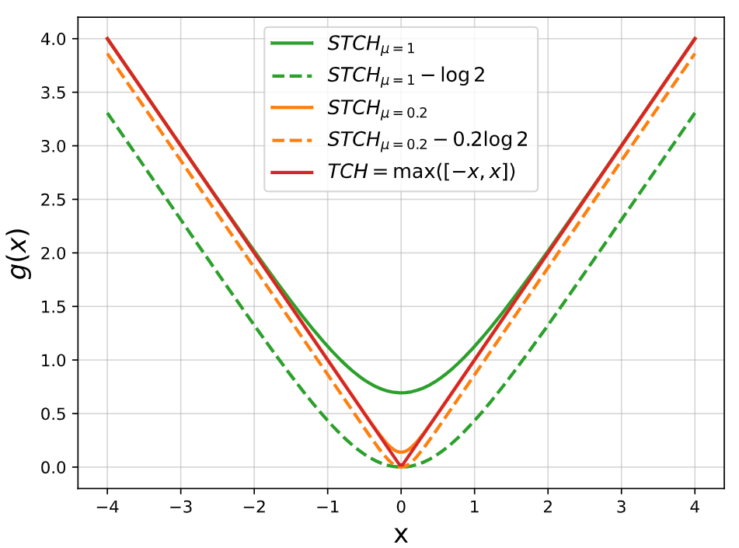
Smooth Tchebycheff Scalarization
Tchebycheff Scalarization
Smooth Tchebycheff Scalarization¹:
¹Lin et. al., Smooth Tchebycheff Scalarization for Multi-Objective Optimization, ICML 2024.

Slide 23
Smooth Tchebycheff Scalarization
Tchebycheff Scalarization
Smooth Tchebycheff Scalarization¹:
STCH is smooth (e.g., differentiable)
TCH is bounded by STCH
STCH -> TCH if u -> 0
¹Lin et. al., Smooth Tchebycheff Scalarization for Multi-Objective Optimization, ICML 2024.

Slide 24
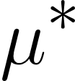
Smooth Tchebycheff Scalarization: Theoretical Properties
Smooth Tchebycheff Scalarization:
Theorem 1(Pareto Optimality). The optimal solution of STCH scalarization is weakly Pareto optimal. In addition, it is Pareto optimal if (1) or (2) the optimal solution is unique.
Theorem 2(All Pareto Solutions). There exists a such that, for any , every Pareto solution of the original multi-objective optimization problem is an optimal solution of the STCH scalarization with some valid preference .
Theorem 3(Pareto Stationary Solutions). If there exists a solution such that , then is a Pareto stationary solution of the original multi-objective optimization problem.
Lin et. al., Smooth Tchebycheff Scalarization for Multi-Objective Optimization, ICML 2024.

Slide 25
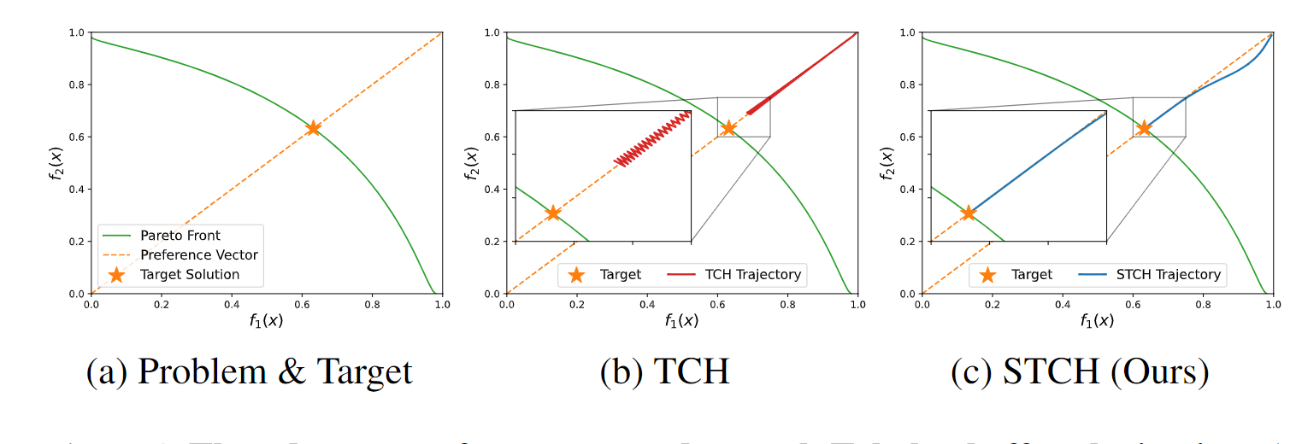
Smooth Tchebycheff Scalarization
Smooth Tchebycheff Scalarization:
Lin et. al., Smooth Tchebycheff Scalarization for Multi-Objective Optimization, ICML 2024.

Slide 26
Smooth Tchebycheff Scalarization
Lin et. al., Smooth Tchebycheff Scalarization for Multi-Objective Optimization, ICML 2024.

Slide 27
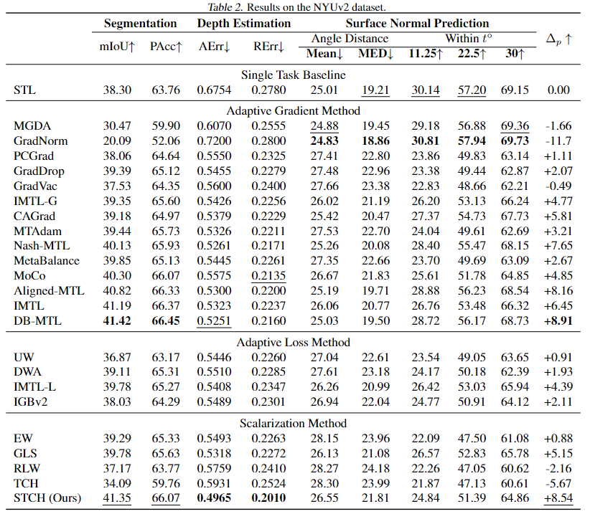
Smooth Tchebycheff Scalarization
Lin et. al., Smooth Tchebycheff Scalarization for Multi-Objective Optimization, ICML 2024.

Slide 28
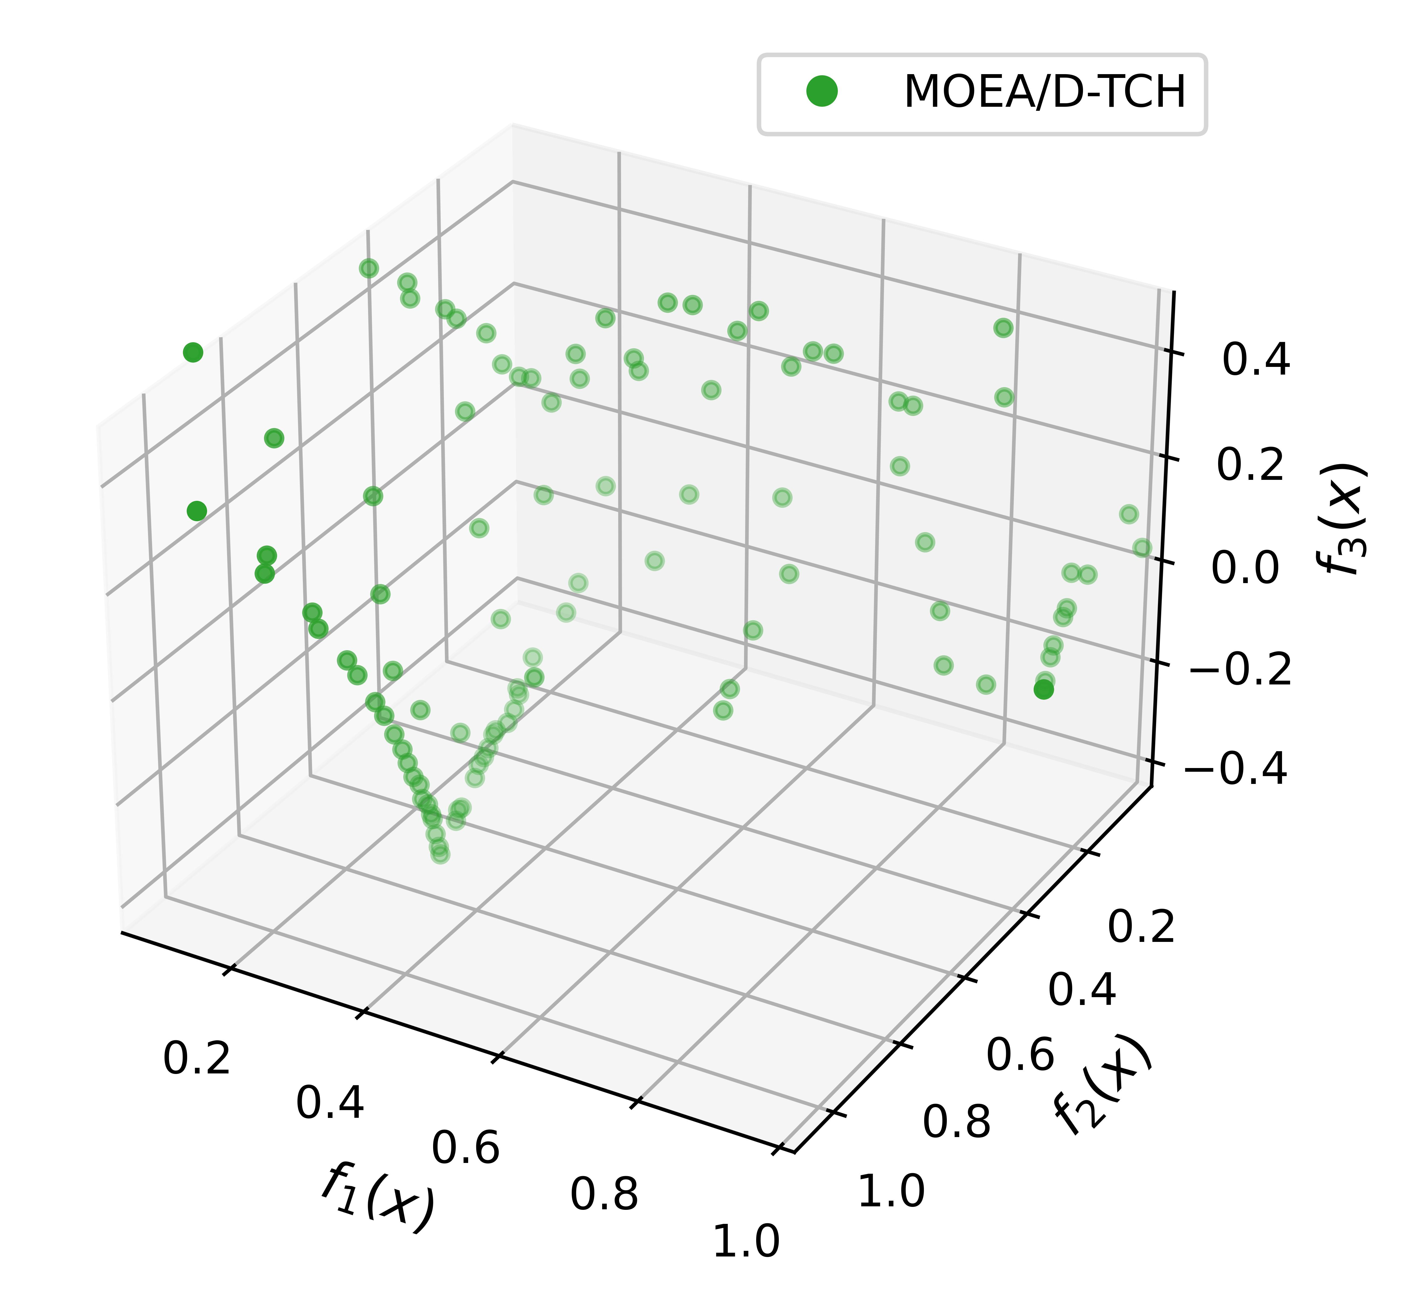
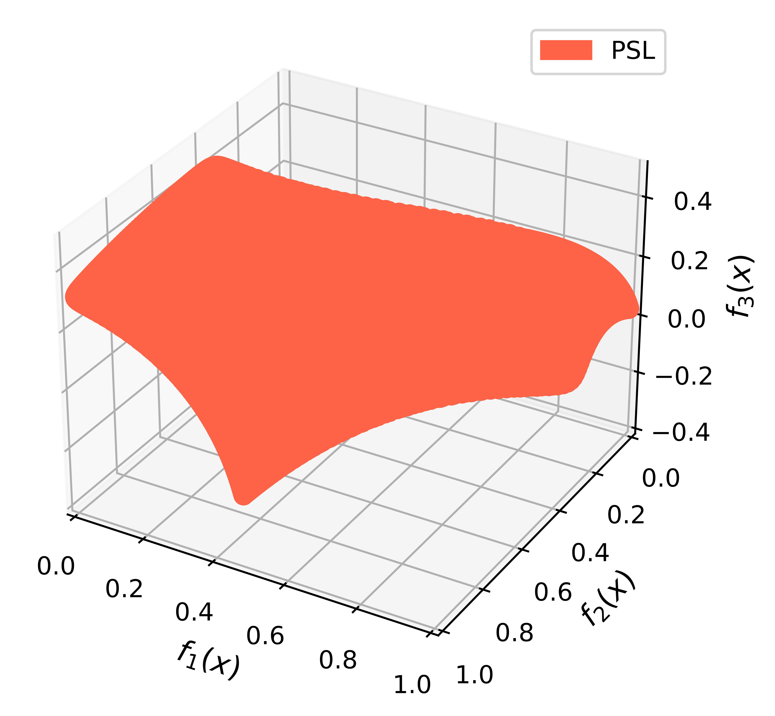
A Finite Set of Solutions is Not Enough
Classical MOEA
Pareto Set Learning
Multi-Objective Rocket Injector Design
( injector face temperature v.s. inlet distance v.s. post tip temperature)
Pareto set could be a low-dimensional manifold
A finite set is not enough to cover the whole Pareto set
User’s most prefered solution(s) is typically not in the finite set
Claus Hillermeier, Generalized homotopy approach to multiobjective optimization. Journal of Optimization Theory and Applications 2001.
Zhang, Zhou, and Jin, RM-MEDA: A Regularity Model-Based Multiobjective Estimation of Distribution Algorithm. IEEE Trans. on Evolutionary Computation 2008.
Giagkiozis and Fleming, Pareto front estimation for decision making. Evolutionary Computation 2014.

Slide 29
Learning the Whole Pareto Set/Front
Goal: Find a Pareto optimal solution
a set of diverse Pareto solutions
a model to approximate the whole Pareto set
Lin et. al., Controllable Pareto Multi-Task Learning, arXiv 2020.

Slide 30
Pareto Set Learning
Goal: Build a model to approximate the whole Pareto set
By adjusting the preferences, decision-makers can explore any trade-off Pareto solutions
on the approximate Pareto set/front.
Lin et. al., Controllable Pareto Multi-Task Learning, arXiv 2020.

Slide 31
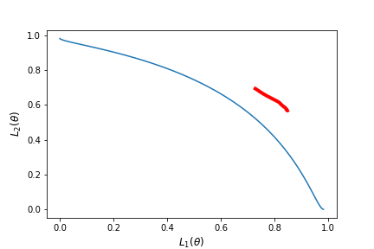
Pareto Set Learning
a) Linear Scalarization b) MGDA c) Pareto MTL d) Pareto Set Learning
Lin et. al., Controllable Pareto Multi-Task Learning, arXiv 2020.

Slide 32
Pareto Set Learning Extensions
Expensive Optimization
Combinatorial Optimization
Connection with Hypervolume Maximization
Lin et. al., Pareto Set Learning for Expensive Multi-Objective Optimization, NeurIPS 2022.
Lin et. al., Pareto Set Learning for Neural Multi-Objective Combinatorial Optimization, ICLR 2022.
Zhang et.al., Hypervolume Maximization: A Geometric View of Pareto Set Learning, NeurIPS 2022.

Slide 33
Other Methods for Learning the Pareto Set
You Only Train Once: Loss-Conditional Training of Deep Networks, ICLR 2019.
PHN: Learning the Pareto Front with Hypernetworks, ICLR 2021.
COSMOS: Conditioned One-shot Multi-Objective Search, ICDM 2021.
Controllable Dynamic Multi-Task Architectures, CVPR 2022.
Learning a Neural Pareto Manifold Extractor with Constraints, UAI 2022.
Improving Pareto Front Learning via Multi-Sample Hypernetworks, AAAI 2023.
Pareto Manifold Learning: Tackling Multiple Tasks via Ensembles of Single-Task Models, ICML 2023.
Multi-objective GFlowNets, ICML 2023.
Sample-Efficient Multi-objective Molecular Optimization with GFlowNets, NeurIPS 2023.
Efficient Meta Neural Heuristic for Multi-Objective Combinatorial Optimization, NeurIPS 2023.
Neural Multi-Objective Combinatorial Optimization with Diversity Enhancement, NeurIPS 2023.
Efficient Pareto Manifold Learning with Low-Rank Structure, ICML 2024.
......

Slide 34
Summary
erE
erE
erE
a) Single Pareto Solution
b) Set of Pareto Solutions
c) Pareto Set Learning
Take-Away: Multi-Objective Optimization is Important for Machine Learning
Current Works: Gradient-based Methods for Training Deep Neural Network
Future Direction: Efficient EMO for Large-Scale Non-differentiable Optimization

